Slide 1
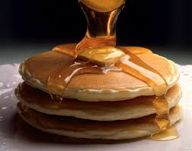
Principles of Pan Frying
CAH II 6.05
Rebecca Benners

Slide 2
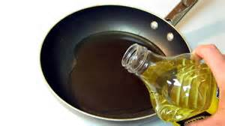
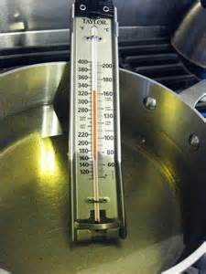
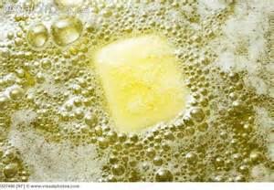
Technique for Pan Frying
Pre-heat enough fat (either oil or clarified butter) in a pan to cover about ½ to ¾ of the food
Oil temperature should be between 350°F and 375°F
Too high – burnt
Too low – oily taste
The fat should be hot enough to sizzle when food is added but not hot enough to smoke

Slide 3
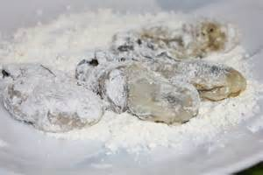
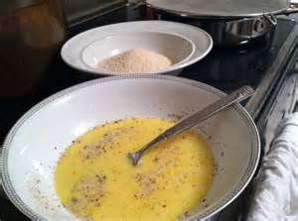
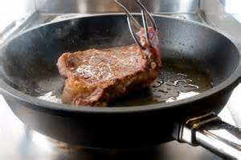
Technique for Pan Frying
Dredge (coat with seasoned flour) and/or bread (dredge, dip in egg wash, then bread crumbs) food prior to cooking.
Pat all food dry if it has any moisture on it.
Oil should be kept at the proper temperature
Allow for rebound (the time it takes for oil to return to proper temperature after cooking a food)
When pan frying chicken or any other food it should only be turned once.
Turning food too often makes it tough.

Slide 4
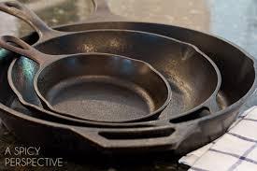
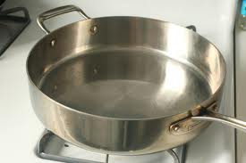
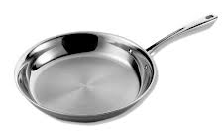
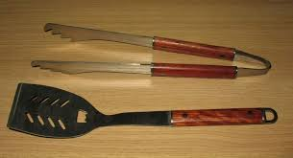
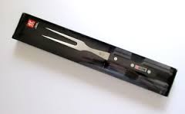
Equipment
Cast Iron Skillet – made from cast iron, retains heat longer and more evenly.
Straight-sided skillet – a skillet with straight sides up about 2 to 4 inches is best for pan frying deep items like chicken
Sauté pan – with sloping sides good for items that will be scooped
Tongs and spatulas – best used for turning
DO NOT USE a meat fork. (for serving only)

Slide 5
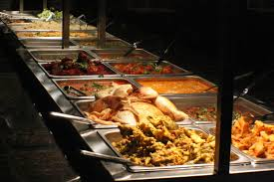
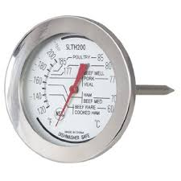
Holding, Service, and Safety
Food may be kept on a buffet line for no more than four hours.
Food must be cooked to its proper minimum internal temperature.
Fruits and vegetables - 135°F.
Chicken - 165°F.
Eggs - 145°F.
Pan fried beef, pork, lamb, or veal-145°F.
Seafood-145°F.

Slide 6
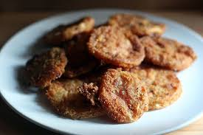
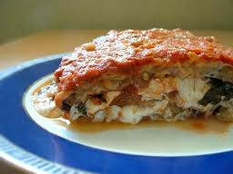
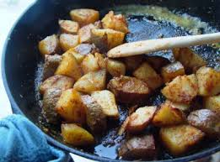
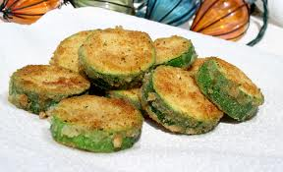
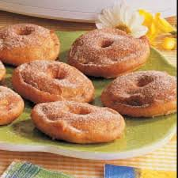
Vegetables and Fruits
Green tomatoes (denser, less moist): sliced, dredged, and fried (Fruit Vegetable)
Eggplant: sliced, salted (to remove strong flavors), dredged and/or breaded, and fried. (Fruit Vegetable)
Potatoes: sliced, shredded, and/or breaded; can be pan fried still or tossed while pan frying (root / tuber)
Squash: sliced, dredged and/or breaded (squash)
Fruits that have skins and will hold up to frying, such as apples (pomes), can also be used

Slide 7
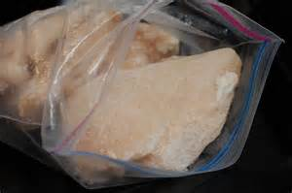
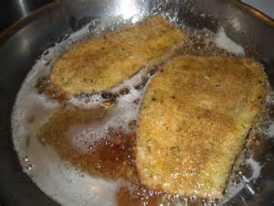
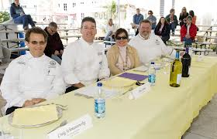
Meat
For the meat to brown before the inside finishes cooking, chill the meat before cooking.
When preparing a veal cutlet for a competition, brown the presentation side first because this is the side that should be face up for judging.

Slide 8
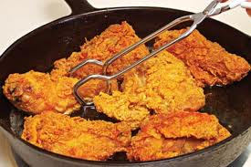
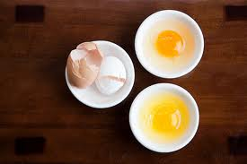
Chicken and Eggs
To pan fry marinated chicken, always pat the chicken dry before cooking to enhance browning.
Very fresh eggs are best for frying.
Fresh eggs hold yolk better and whites run less.
A fried egg has its yolk broken while pan frying.

Slide 9
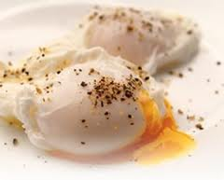
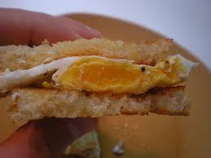
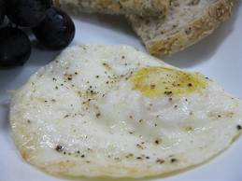
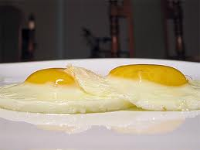
Types of Fried Eggs
Over Easy – cooked on both sides with the yellow/yolk slightly runny
Over medium – cooked on both sides with the yolk almost firm
Over hard – cooked on both sides with a hard yolk
Sunny side up – eggs cooked with the yolks up on one side

