Slide 1
Moist Cooking Methods
CAH I 1.03

Slide 2
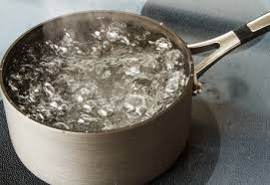
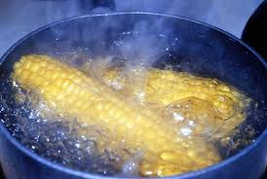
Boiling
The Method
A rapid
MOIST cooking method where liquid is heated to the boiling point (212 ºF) and kept at that temperature while the food cooks and
the water cooks the food through convection
Because of the rapid motion of the water very few foods can be boiled because they will easily break.
Insert Videos

Slide 3
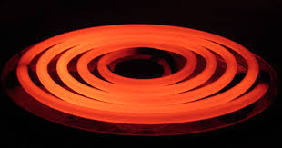
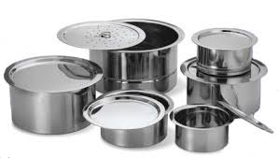
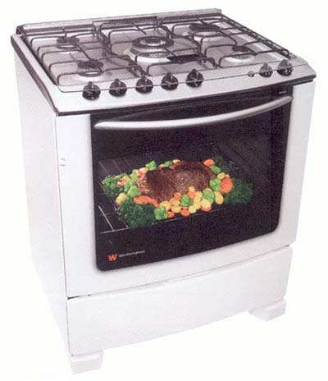
Boiling
Equipment
Range
Burners
Stockpot
Sauce Pan
Tips
Use naturally tough foods, like pasta and some vegetables
Begin boiled potatoes with just enough cold water to cover.
Otherwise, allow the water to come to a complete boil so food will not stick to pan

Slide 4
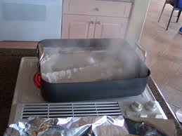
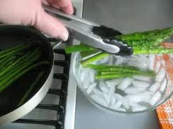
Parboiling/blanching
The Method
Parboiling: MOIST cooking method where foods are put into boiling water and partially cooked (Think several minutes or so) in order to tenderize them or prepare them for other methods; a process similar to blanching.
The Method
Blanching: MOIST cooking method in which food is plunged into boiling water briefly (typically enough time for the boiling to enhance the color of a vegetable) and then plunged into ice water to stop the cooking process from continuing.
Insert Videos

Slide 5
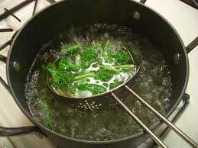
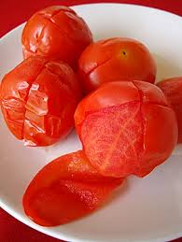
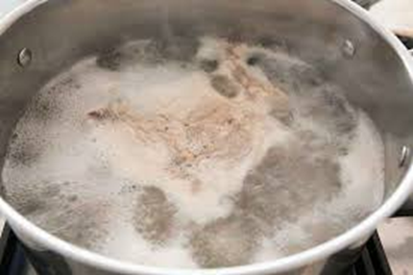
Parboiling / Blanching
Equipment
Stockpot
Saucepan
Range
Tips
Great if you want to partially cook a food before freezing, lock in color, preserve nutrients, remove excess salt, and remove unwanted things such as blood or strong flavor.
Ribs are often parboiled before grilling in order to tenderize them.

Slide 6
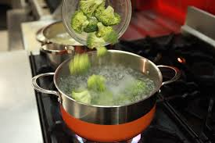
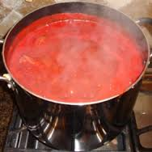
Simmering
The Method
Simmering: MOIST cooking method during which food cooks steadily and slowly in a liquid slightly below boiling (185-200ºF) and is not rough like boiling.
Video:

Slide 7
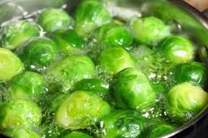
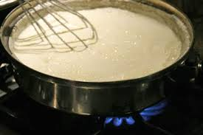
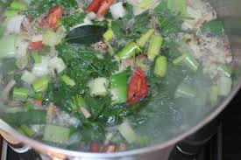
Simmering
Equipment
Stockpot
Saucepan
Range
Tips
Most common for delicate vegetables
Also used when reducing sauces because it minimizes evaporation compared to boiling.
Used for long, slow cooking tasks such as making stocks

Slide 8
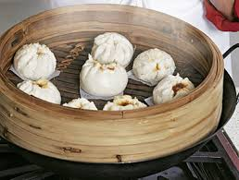
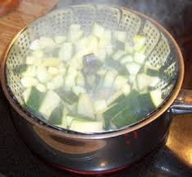
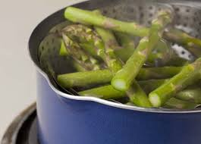
Steaming
The Method
Steaming: MOIST cooking method in which foods are placed in a steamer (either basket or similar design) above boiling water and the steam cooks the food in a closed environment and without losing nutrients.
Faster and healthier than other moist cooking methods because steam is actually hotter than water and you lose less nutrients.
Video:

Slide 9
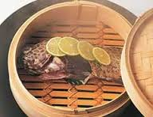
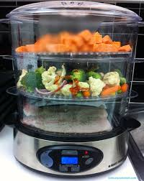
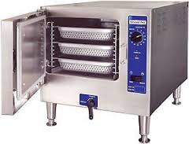
Steaming
Equipment
Steamer
Stockpot w/ steamer insert
Saucepan w/ steamer insert
Range
Tips
Season foods after steaming or add aromatics during cooking
Rice may also be steamed; less likely to stick or burn than on stovetop
Cook until fork tender

Slide 10
Apply It
What equipment can be used for two or more methods?
What preparation is done to food before blanching?
How are steamed products given their flavor(2 ways)?
What equipment is used for simmering?
How are boiled foods different from other moist heat foods?
What are the minimum internal temperatures for: chicken, beef, vegetables, and pork?

