Slide 1
Dry Cooking Methods
CAH I 1.02

Slide 2
Sautéing
The Method
quick
DRY cooking technique
uses a small amount of fat or oil in a shallow pan.
Mostly used with delicate foods like fish fillets, scallops, spinach.
When sautéing, first preheat the oiled pan to almost the smoke point
Video: https://www.youtube.com/watch?v=KkBxbBivUFc

Slide 3
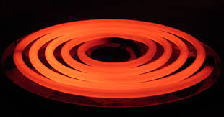
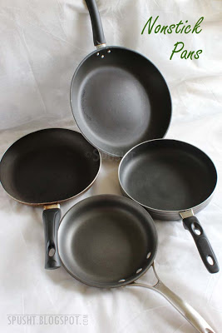
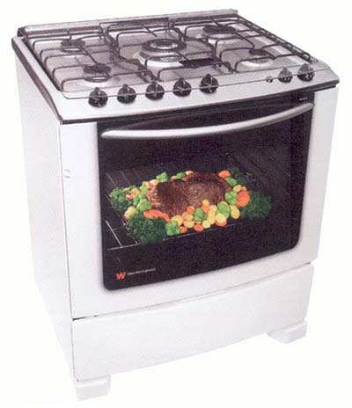
Sautéing
Equipment
Range
Burners
Sauté Pan
Wok (sometimes)
Tips
Use naturally thin foods, like fish fillets, or cut food into thin portions
Heat oil in the pan
Gently cook food, stirring occasionally.

Slide 4
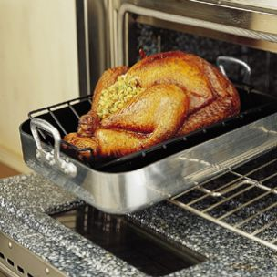
Roasting
The Method
DRY heat method
food is seared then placed on a rack above a drip pan which provides for air circulation in the closed oven environment.
Roasting is a long process, often includes cuts of meat and poultry, and uses carry over cooking (What is that?)
Video: https://www.youtube.com/watch?v=82cfjYHx1zs
http://video.about.com/americanfood/How-to-Roast-Chestnuts.htm
http://video.about.com/italianfood/Roasted-Red-Pepper.htm
http://video.about.com/gourmetfood/Slow-Roasted-Lamb-Shanks.htm

Slide 5
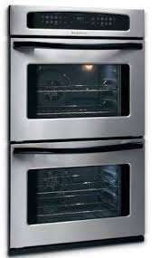
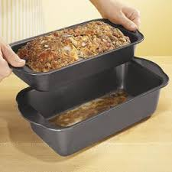
Roasting
Equipment
Hotel pan or sheet pan
Convection or Deck oven
Loaf pan or Tube pan
Roasting Pan
Method
Use food with a natural “crust” like whole chicken or sear food to lock in the juices and dark color
Put meat on roasting pan and place in the oven on low heat for a long amount of time.
For Vegetables:
Cut into small 1 to ½” chunks, toss in vegetable oil and seasonings, and cook at medium high heat for long amount of time

Slide 6
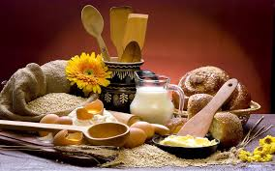
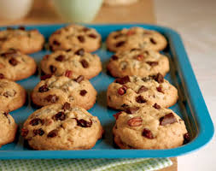
Baking
The Method
DRY heat method where
No liquid or fat is used (except sometimes to prevent sticking) and
Takes place in a closed environment.
Fish, vegetables, fruits, and pastries are often baked and carry over cooking can occur (Why does this happen?)
French Macarons Video: https://www.youtube.com/watch?v=tWlTJBWjmGk

Slide 7
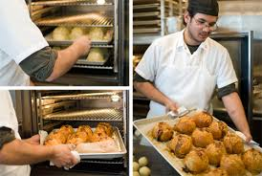
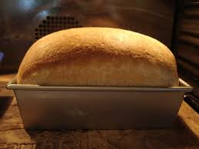
Baking
Equipment
Hotel pan or sheet pan
Convection or Deck oven
Range
Loaf pan or Tube pan
Roasting Pan
Method
Shape dough as desired for biscuits or cookies or rolls or pour batter into desired pan, like loaf or bundt to achieve different shapes
Put product in pre-heated oven, approximately 350-400 and bake for prescribed time
Food is ready when it is golden brown on outside and edges

Slide 8
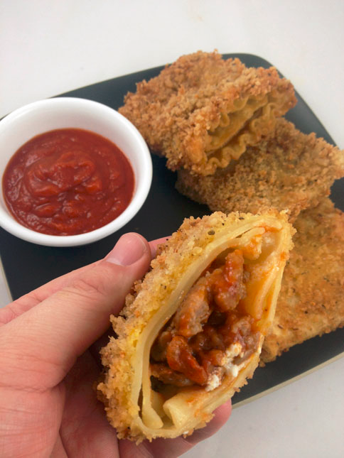
Deep Frying
The Method
DRY heat method.
Food is completely submerged in heated fat or oil.
Temperatures between 350-375ºF.
Food must be cooked until done on the inside, typically are battered before cooking and usually include potatoes, onions, fish and poultry.
When deep frying, fill the basket ½ full with food.
Video:
https://www.youtube.com/watch?v=Ei7oxT4LIjU

Slide 9
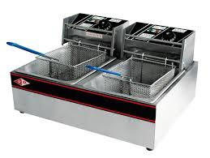
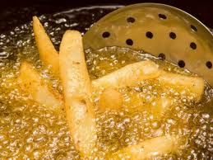
Deep Frying
Equipment
Deep Fryer
Sauce pot
Cast Iron Skillet
Fry Baskets or Slotted Spoon
Method
Season foods as needed and dredge them and/or batter or bread them
Foods needs to be as dry a possible
Gently lower into oil
Cook until golden brown and at the proper minimum internal temperature

Slide 10
Apply It
What equipment can be used for two or more methods?
What preparation is done to food before deep-frying?
How are baked products given their shapes (2 ways)?
What equipment is used for roasting?
How are sautéed foods different from other dry heat foods?
What are the minimum internal temperatures for: chicken, beef, vegetables, and pork?

